Slide 1
Categories, Classification, Measurement and Scales

Slide 2
Abraham Lincoln
“The shepherd drives the wolf from the sheep's throat, for which the sheep thanks the shepherd as his liberator, while the wolf denounces him for the same act…. Plainly the sheep and the wolf are not agreed upon a definition of liberty.”

Slide 3
Assuming the ideal
Most introductory texts focus on the logical procedures of statistics and assume that the categories (the data) upon which the procedures are apllied are “ideal.”
Data about people <> ideal
Also, makes researcher focus too much on technical technique

Slide 4
Imprecision in discussion
A conversation works because it is not precise and because there is a tacit acceptance of what is meant by any vague terminology
Remember from lecture 1
A typical ‘building’
A typical ‘Senator’

Slide 5
Example
“My husband Ralph is good enough, I suppose, but when I add everything up, I can’t help thinking he’s a failure.”
The category “failure” tells us something, but what?
It pretty much only tells us that she has a negative opinion of his efforts.

Slide 6
Need more information
If we listened longer, maybe we’d get a better sense of what “failure” means to this woman
We can begin to see how “Social Categories” are typically defined by elaborate stories that keep filling in the particulars
Recall the definition of a student from lecture 1

Slide 7
No Time
In statistics, we don’t have time for elaborate stories about each particular case
This is usually the case in policy making as well
When you are dealing with millions of people, the simplest categorization is needed
Suppose each of us could tell our life story in 500 pages
If we published this for the US, we’d have more than 125 BILLION pages!
If each 500 page volume were 1 inch thick, we’d have a report 4000 miles thick!

Slide 8
Statistics - The Reasoned Simplification of Events
Statistical thinking and procedures are essential
The trick is to minimize distortion
More specific definition of statistics: an effort to achieve comprehensive, simplified descriptions of the world that minimize distortion

Slide 9
Literature vs. Statistics
Opposite ends of the same continuum
As we move in one direction, we lose the advantages of moving in the other – we must compromise
We can substitute “qualitative methods” for the “literature”
This process of combining (compromising) is the process of “categorization”

Slide 10
Two fundamental points
No way to avoid arbitrarily simplified categorization when doing statistical analysis
Arbitrarily simplified categories create serious problems in the quest for precision

Slide 11
Example
The Statistical Abstract of the United States uses the categories “minority” and “white” to divide populations into ethnic or racial categories
These are abstracted terms
Korean in LA running a shop and an eskimo building an igloo have little in common
Tiger Woods and a Navaho Indian living in a trailer in the desert have little in common
They all fit into “minority” – what is the use of this category?

Slide 12
How do we deal with categorization?
Social scientists have come up with different “categories” of “categories” to help discern what type of data we are dealing with, and, therefore, how precise we can get while working with the data
Levels of Measurement

Slide 13
The Levels of Measurement
Nominal
Ordinal
Interval
Ratio

Slide 14
Some Definitions
Variable

Slide 15
Some Definitions
Variable
Attribute
Attribute

Slide 16
Some Definitions
Variable
Gender
Attribute
Attribute

Slide 17
Some Definitions
Variable
Gender
Attribute
Attribute
Female
Male

Slide 18
Qualities of Variables
Exhaustive -- Should include all possible answerable responses.
Mutually exclusive -- No respondent should be able to have two attributes simultaneously (for example, employed vs. unemployed -- it is possible to be both if looking for a second job while employed).

Slide 19
What Is Level of Measurement?
The relationship of the values that are assigned to the attributes for a variable

Slide 20
What Is Level of Measurement?
The relationship of the values that are assigned to the attributes for a variable
Relationship

Slide 21
What Is Level of Measurement?
The relationship of the values that are assigned to the attributes for a variable
1
2
3
Values
Relationship

Slide 22
What Is Level of Measurement?
The relationship of the values that are assigned to the attributes for a variable
Attributes
Republican
Independent
Democrat
1
2
3
Values
Relationship

Slide 23
What Is Level of Measurement?
The relationship of the values that are assigned to the attributes for a variable
Variable
Party Affiliation
Attributes
Republican
Independent
Democrat
1
2
3
Values
Relationship

Slide 24
Why Is Level of Measurement Important?
Helps you decide what statistical analysis is appropriate on the values that were assigned
Helps you decide how to interpret the data from that variable

Slide 25
Nominal Measurement
The values “name” the attribute uniquely.

Slide 26
Nominal Measurement
The values “name” the attribute uniquely.
The name does not imply any ordering of the cases.

Slide 27
Nominal Measurement
The values “name” the attribute uniquely.
The value does not imply any ordering of the cases, for example, jersey numbers in football.

Slide 28
Nominal Measurement
The values “name” the attribute uniquely.
The value does not imply any ordering of the cases, for example, jersey numbers in football.
Even though player 32 has higher number than player 19, you can’t say from the data that he’s greater than or more than the other.

Slide 29
Ordinal Measurement
When attributes can be rank-ordered…

Slide 30
Ordinal Measurement
When attributes can be rank-ordered…
Distances between attributes do not have any meaning.

Slide 31
Ordinal Measurement
When attributes can be rank-ordered…
Distances between attributes do not have any meaning,for example, code Educational Attainment as 0=less than H.S.; 1=some H.S.; 2=H.S. degree; 3=some college; 4=college degree; 5=post college

Slide 32
Ordinal Measurement
When attributes can be rank-ordered…
Distances between attributes do not have any meaning,for example, code Educational Attainment as 0=less than H.S.; 1=some H.S.; 2=H.S. degree; 3=some college; 4=college degree; 5=post college
Is the distance from 0 to 1 the same as 3 to 4?

Slide 33
Interval Measurement
When distance between attributes has meaning…

Slide 34
Interval Measurement
When distance between attributes has meaning, for example, temperature (in Fahrenheit) -- distance from 30-40 is same as distance from 70-80

Slide 35
Interval Measurement
When distance between attributes has meaning, for example, temperature (in Fahrenheit) -- distance from 30-40 is same as distance from 70-80
Note that ratios don’t make any sense -- 80 degrees is not twice as hot as 40 degrees (although the attribute values are).

Slide 36
Ratio Measurement
Has an absolute zero that is meaningful

Slide 37
Ratio Measurement
Has an absolute zero that is meaningful
Can construct a meaningful ratio (fraction)

Slide 38
Ratio Measurement
Has an absolute zero that is meaningful
Can construct a meaningful ratio (fraction), for example, number of clients in past six months

Slide 39
Ratio Measurement
Has an absolute zero that is meaningful
Can construct a meaningful ratio (fraction), for example, number of clients in past six months
It is meaningful to say that “...we had twice as many clients in this period as we did in the previous six months.

Slide 40
The Hierarchy of Levels
Nominal

Slide 41
The Hierarchy of Levels
Nominal
Attributes are only named; weakest

Slide 42
The Hierarchy of Levels
Ordinal
Nominal
Attributes are only named; weakest

Slide 43
The Hierarchy of Levels
Ordinal
Attributes can be ordered
Nominal
Attributes are only named; weakest

Slide 44
The Hierarchy of Levels
Interval
Ordinal
Attributes can be ordered
Nominal
Attributes are only named; weakest

Slide 45
The Hierarchy of Levels
Interval
Distance is meaningful
Ordinal
Attributes can be ordered
Nominal
Attributes are only named; weakest

Slide 46
The Hierarchy of Levels
Ratio
Interval
Distance is meaningful
Ordinal
Attributes can be ordered
Nominal
Attributes are only named; weakest

Slide 47
The Hierarchy of Levels
Ratio
Absolute zero
Interval
Distance is meaningful
Ordinal
Attributes can be ordered
Nominal
Attributes are only named; weakest

Slide 48
Why do we categorize our variables like this?
Different levels call for different methods
You can convert down but not up!
Can’t get “better” information by assigning numbers to nominal categories for the purposes of doing math with them

Slide 49
Quiz – 30 seconds
What level of measurement are the following variables most likely to be?
Whether a city is located in Illinois or Ohio or Indiana
Traffic fatalities
Attitude toward health maintenance organizations (HMOs)
School Enrollment

Slide 50
Task
Think about and write down three qualities of a top Masters of Public Administration Program
What makes for a “great” MPA program
Take 10 minutes
Now, how would you measure each one of these qualities?
What level of measurement are we dealing with with each indicator?

Slide 51
Good Indicators
Most Importantly
Valid
Reliable
But also
Comprehensible
Cost Effective

Slide 52
Indicator needs to be “Valid”
“Construct” Validity
Should measure what it is supposed to measure
Can be very difficult
What if you want to measure public opinion on an issue?
Who’s the public?
Does it change depending on the issue?
White vs. minority?

Slide 53
Construct Validity Example
The Prudeville police are directed to “crack down” on prostitution in the city
The police chief increases daily arrests by the vice squad from 3.4 to 4.0
Police chief goes to council to show success
What is the construct validity problem?

Slide 54
An indicator needs to be reliable
Can you repeat it and get the same results?
Will it get what you are trying to get?
Will it NOT get what you are NOT trying to get?

Slide 55
Reliability and Validity
Reliable but not valid

Slide 56
Reliability and Validity
Valid but not reliable

Slide 57
Reliability and Validity
Neither reliable nor valid

Slide 58
Reliability and Validity
Reliable and valid

Slide 59
People need to understand your indicator
Comprehensibility
Will people and/or policy makers understand it?
The farther removed the indicator is from the subject it purports to measure, the easier it is to be dismissed
Need to clearly link variables for the audience
What if you could link free daycare services to prostitution levels in Prudeville?
Even if it is an indicator, it might be very difficult to get the point across to policy makers or the public

Slide 60
You need to be able to afford the data collection
What will it cost to collect this indicator?
Are there other indicators that might be just as good for less cost?
Can a trade-off be made that will still be satisfactory?

Slide 61
Exercise
In four groups:
Think of two possible indicators to measure for each concept.
Citizen support for the current city government
The incidence of chronic illness among those over 65 in your state
Citizen satisfaction with garbage collection in your community
Discuss each measure in terms of potential validity, reliability, comprehensibility, and cost

Slide 62
Indexes and Scales
Often we cannot contain a concept with a single measure
How would we determine if someone is a Blacksburg resident?
Many times, we will combine measures to form what is commonly referred to as either an index or a scale
Can we think of any common indexes?

Slide 63
Indexes and Scales
Indexes can be constructed from items in
Public Opinion Surveys
Data in Public Records
Personal Observations
An indexes size is generally dictated by the respondents'’ willingness to answer
Nobody will want to respond to a 200 item survey
Usually 2 to 10 items

Slide 64
Indexes and Scales
The simplest indexes involve merely adding together several responses
More complicated indexes provide “weights” for different factors

Slide 65
Example
Suppose you’re researching divorce rates and you’re wondering if a husband’s willingness to share in the household duties has any bearing on the outcome
To measure this, you might ask the husband how much times he spends doing household chores
Would this be reliable?

Slide 66
Example cont.
Instead you might construct a scale composed of something like:
Which of the following household chores do you regularly do (check all that apply)
Washing up after meals
Preparing meals
Doing the laundry
Routine household cleaning
Shopping for groceries
Caring for the children
Could ask spouse to verify for reliability
Add together to get a score (index number) between 0-6

Slide 67
Example cont.
Problem
Are all chores equal in magnitude?
Solution 1
Give each chore some weight based on relative importance
Maybe .3 for childcare?
Maybe .2 for laundry?
.1 for everything else?

Slide 68
Example cont.
Solution 2
Assess the proportion of work done
Maybe give weights to each level
 | almost always | usually | half the time | occasionally | almost never
Washing up after meals
Preparing meals
Doing the laundry
Routine household leaning
Shopping for Groceries
Caring for children

Slide 69
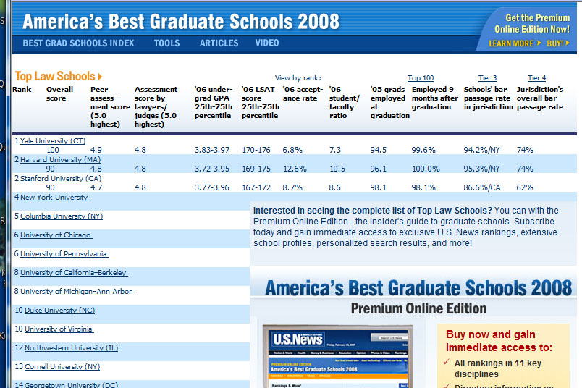
School Rankings (Indexes)

Slide 70
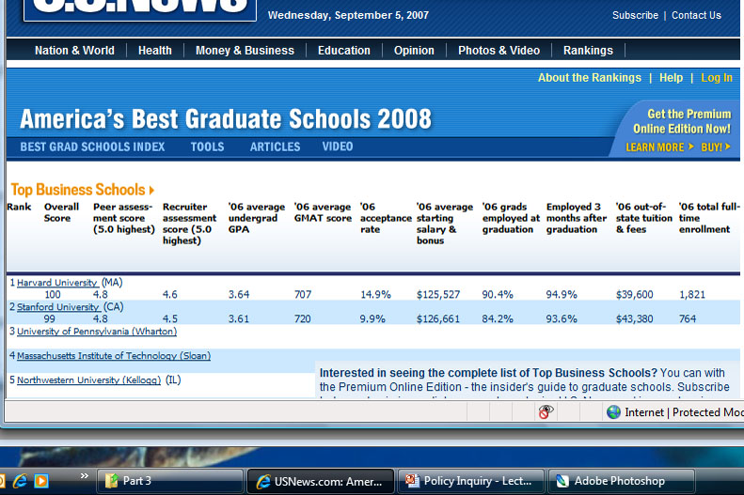
School Rankings (Indexes)

Slide 71
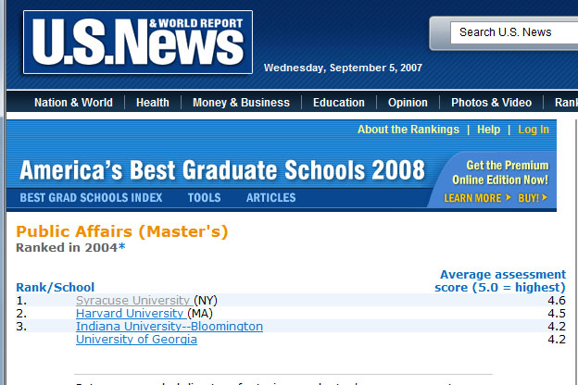
School Rankings (Indexes)

Slide 72
Assignment
You are given an assignment to come up with a survey of MPA students past and present about the MPA program
You need to measure both the perceived quality of the program and the general student satisfaction with their experience
Come up with 4 indicators that will need to be measured to get at each concept (8 total).
Describe why each is a good indicator for the concept it represents
Tell which level of measurement each indicator represents
Suggest an index that will summarize all of your indicators

